Slide 1

基于Stable Diffusion的
自定义时尚服装设计与试穿
MARKETING
www.opencherry.com
MARKETING PLAN

Slide 2
包含：封面页、目录页、市场策略（Marketing Strategy），目标人群（Audience），预算（Budget），路径拆解（Roadmap），总结（Summary），结束页
设计理念
用户体验
01.
03.
此处输入你的正文内容
为了最终演示发布良好效果
此处输入你的正文内容
为了最终演示发布良好效果
TEMPLATE
技术讲解
营销策略
02.
04.
此处输入你的正文内容
为了最终演示发布良好效果
此处输入你的正文内容
为了最终演示发布良好效果
CONTENTS
www.opencherry.com
MARKETING PLAN

Slide 3


用户体验
USER INTERFACE
OPENCHERRY
线性使用流程
01
PART ONE
www.opencherry.com
USER INTERFACE

Slide 4
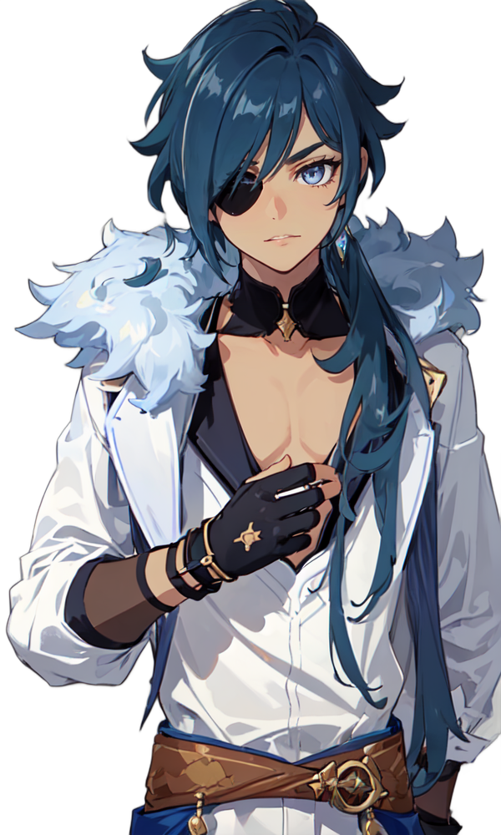
Functions
Part Two
Cloth Designing
Virtual Models
服装设计
自定义创作
虚拟模特更衣试穿
满足你的幻想
Cyber Runway Show
Community network
赛博走秀
老子怎么穿都好看
社区交流创意
自由接单交易

Slide 5
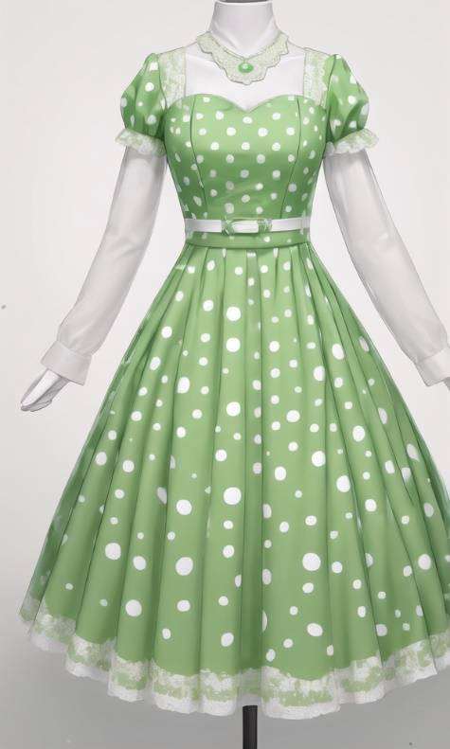
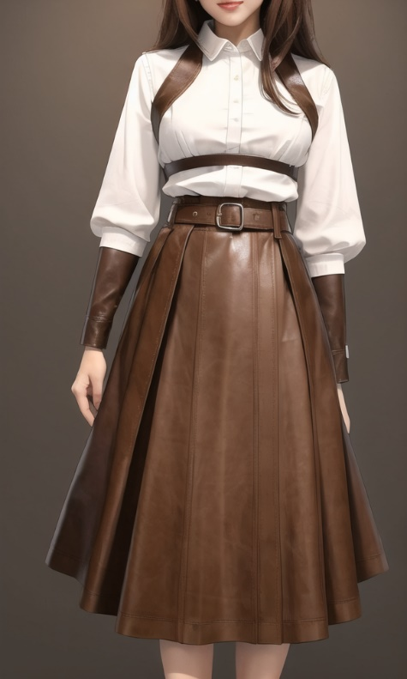
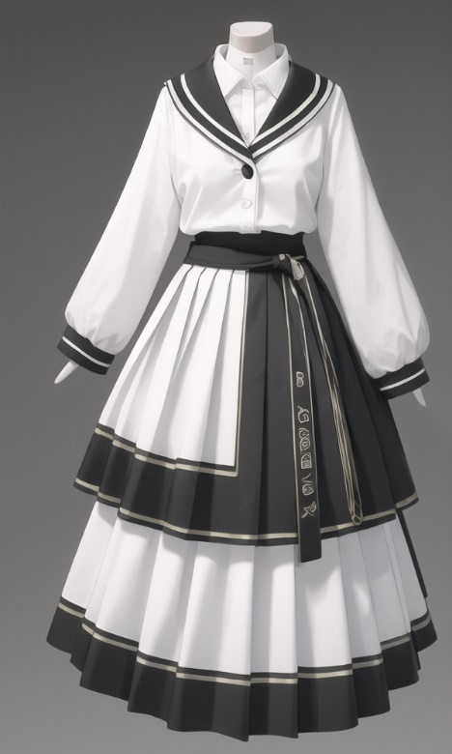
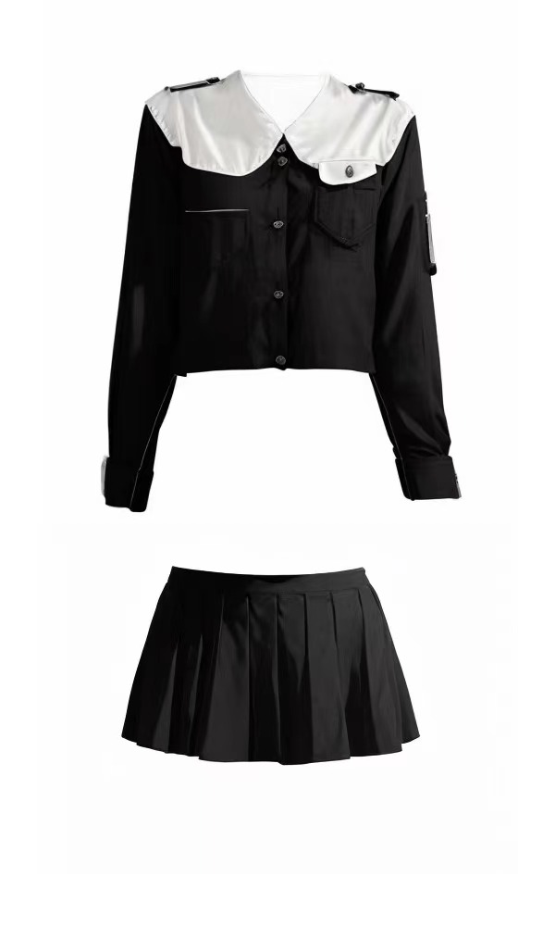
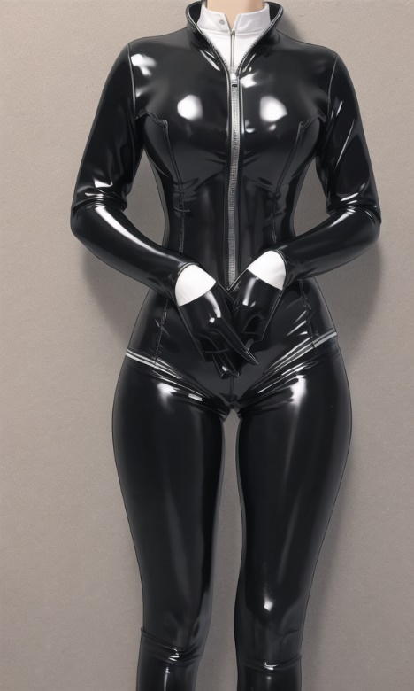
Clothing Designing
Part Two
SLIDE DESIGN
TEMPLATE
Come and try !!!

Slide 6



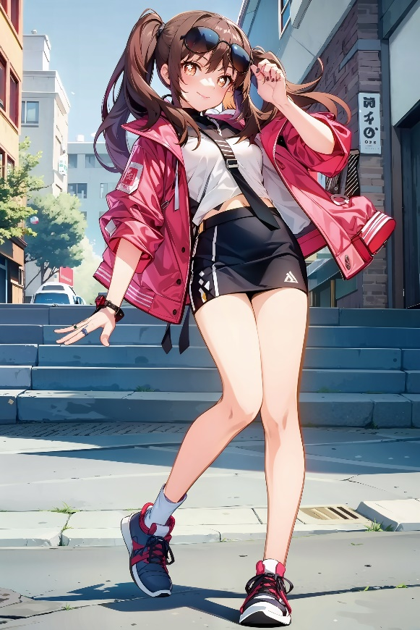
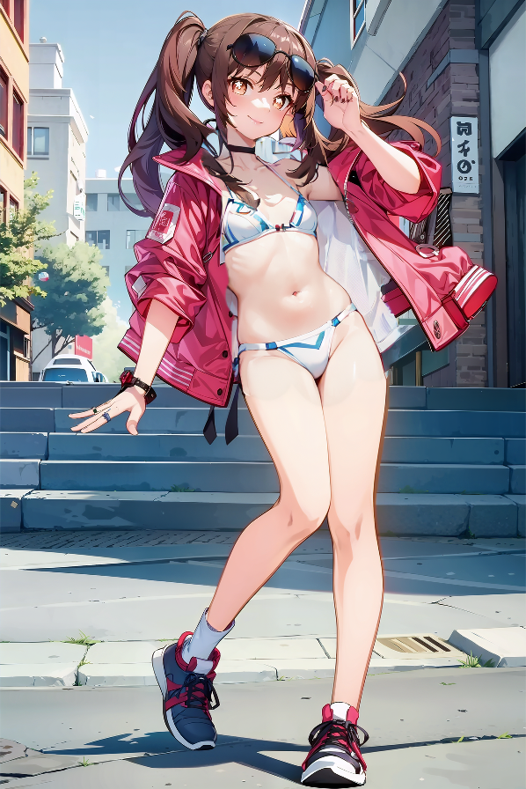

Virtual Models
Part Two
SLIDE DESIGN
Come and try !!!

Slide 7







Cyber Runway Show
Part Two
SLIDE DESIGN
Come and try !!!

Slide 8
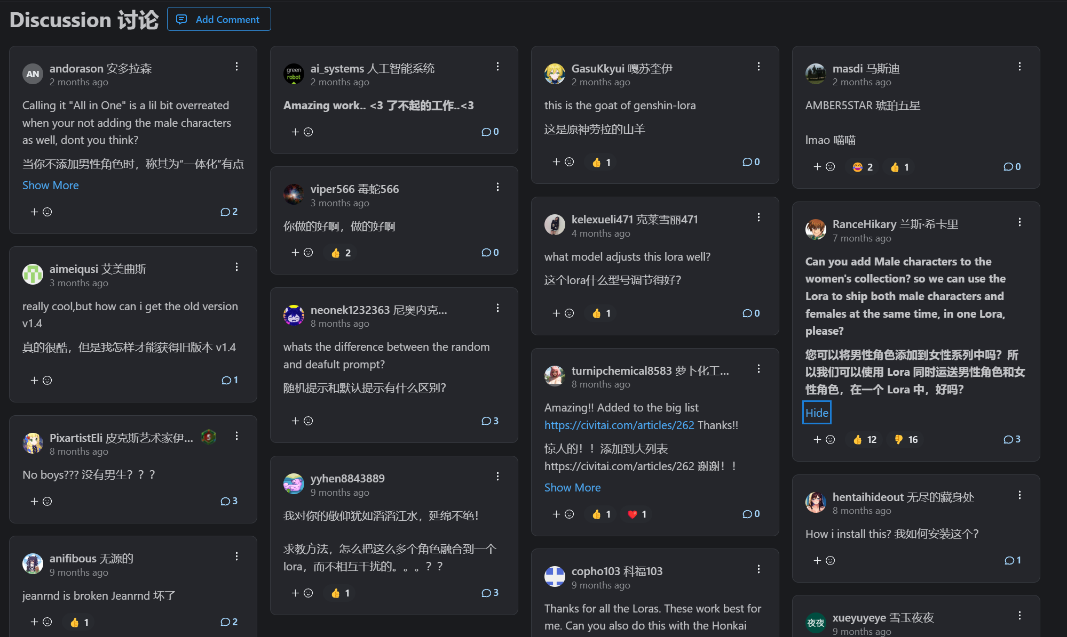
Community network
Part Two
SLIDE DESIGN
Come and try !!!

Slide 9

OPENCHERRY
技术讲解
TECH INTRO
02
后端原理
PART TWO
www.opencherry.com
TECH INTRO

Slide 10
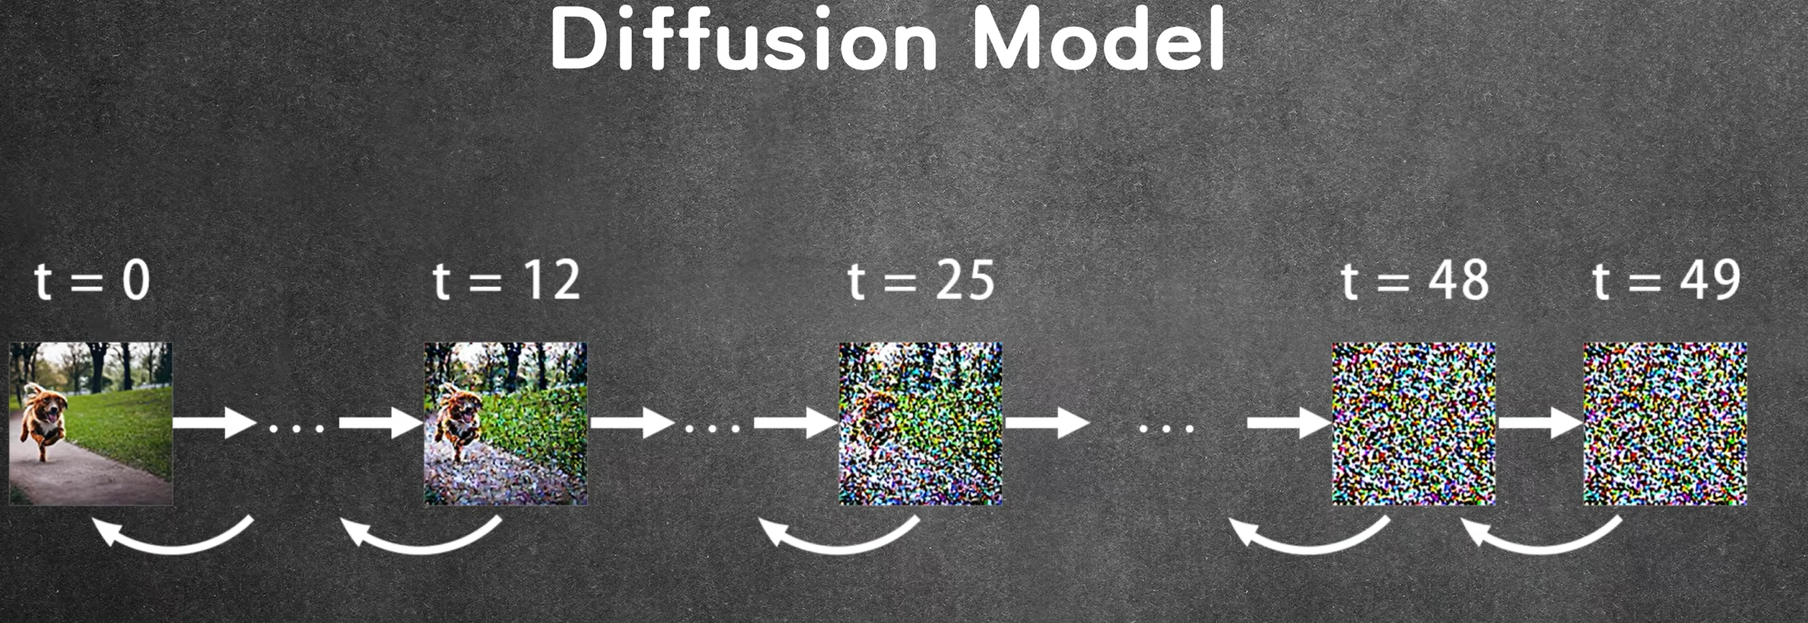
Backend workflow
Part Two
TEMPLATE
Basics
Image after adding noise
A new image
Clear image
MARKETING PLAN

Slide 11

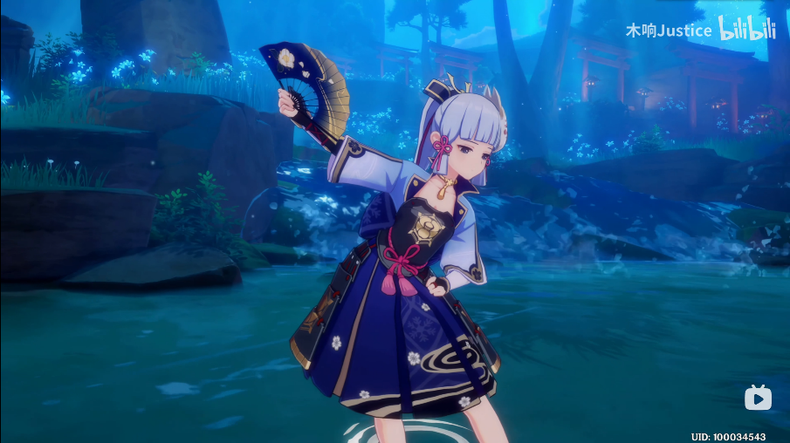

Backend workflow
Part Two
TEMPLATE
Metaphor
Without your glasses
With your glasses
guessing、guessing、guessing
MARKETING PLAN

Slide 12
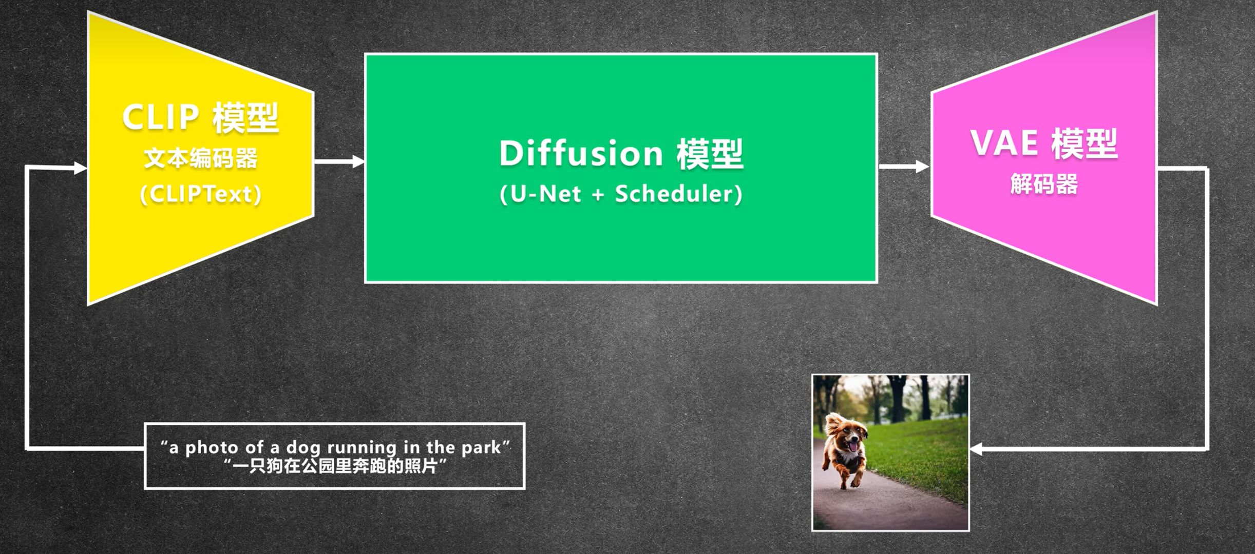
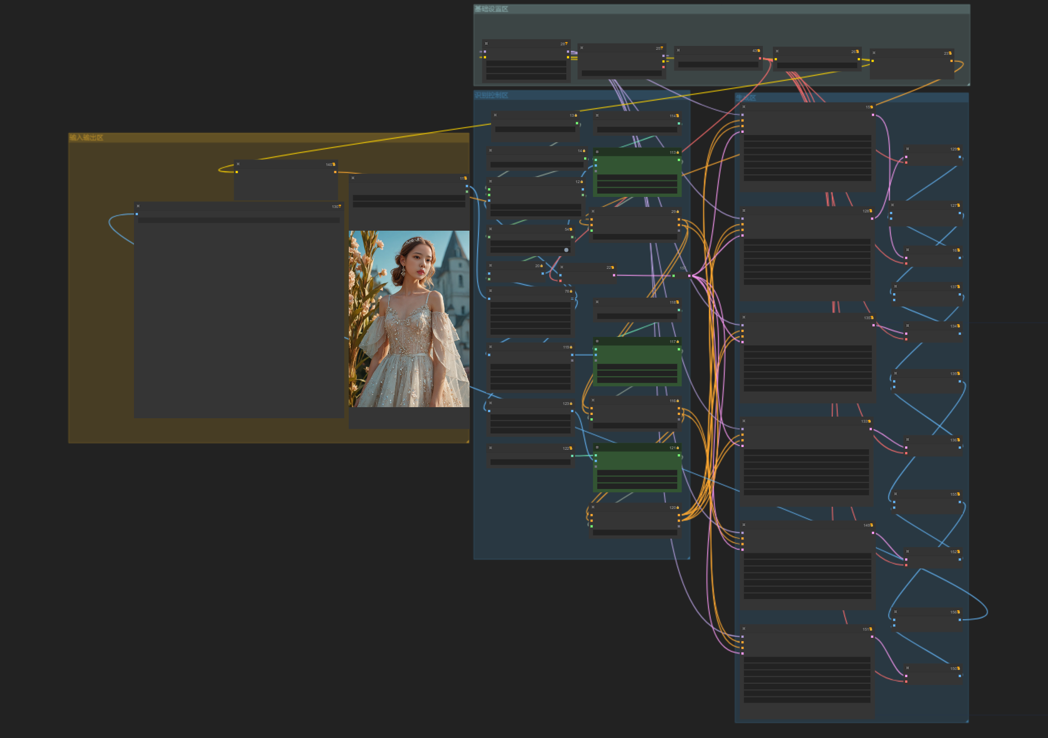
This time we added the "remove background" function to the code
Part Three
Workflow
Part Two
TEMPLATE
添加标题
添加标题
单击此处输入你正文内容，文字是您思想的提炼，为了最终演示发布的良好效果
单击此处输入你正文内容，文字是您思想的提炼，为了最终演示发布的良好效果
This time we added the “remove background” function to the code.
MARKETING PLAN

Slide 13

设计理念
DESIGN CONCEPT
OPENCHERRY
03
PART THREE
www.opencherry.com
DESIGN CONCEPT

Slide 14
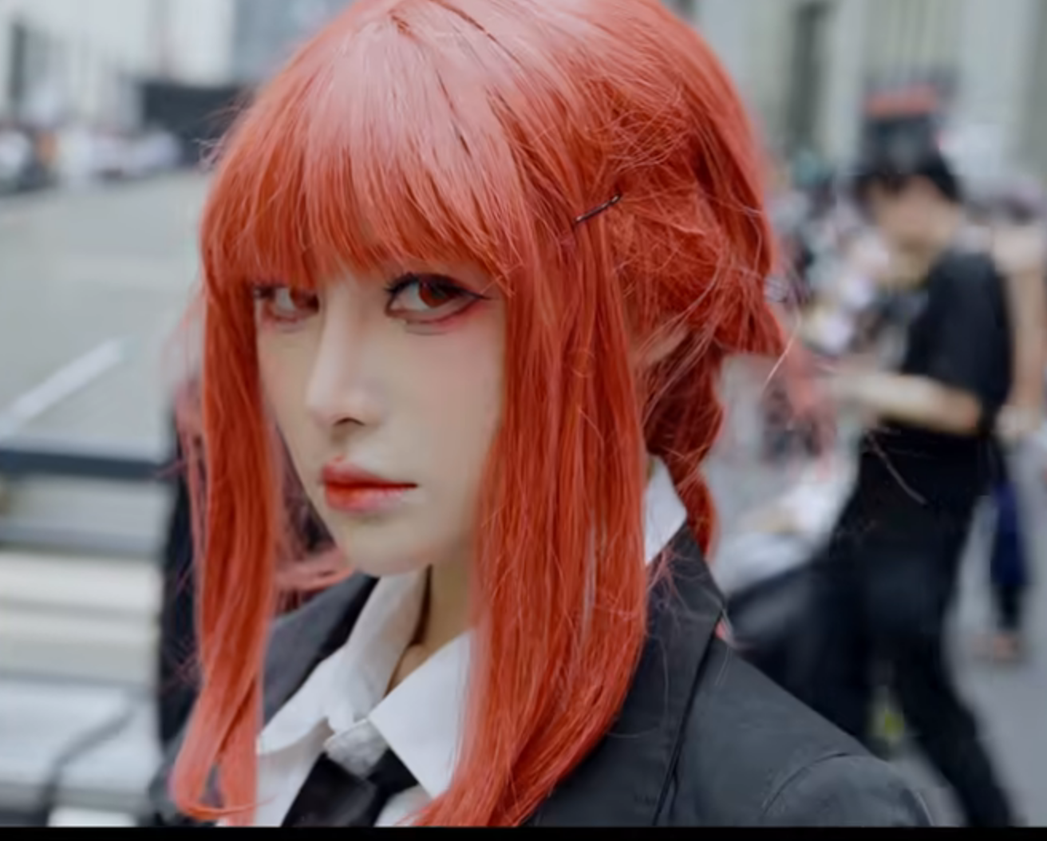
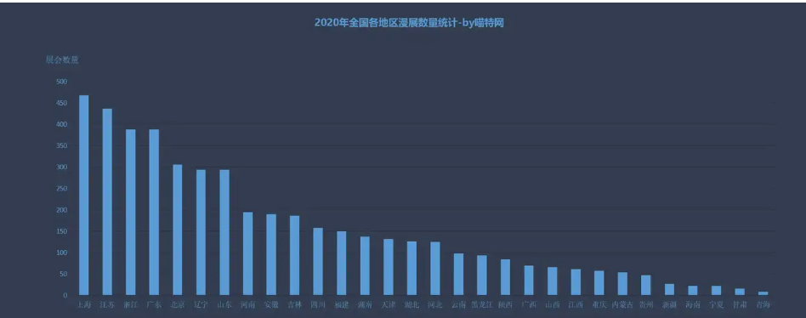
WPS TEMPLATE
PRESENTATION//SLIDE
Part Three
User demographic analysis
SLIDE DESIGN
TEMPLATE
Targeting Coser
Targeting
E Person
Targeting
Fashion designers
Our design philosophy is tailored to the aforementioned audience, meeting their specific needs.
With the development of the times, the number of ACG lover communities has increased, and the derivative industry of animations, such as cosplay, has developed rapidly in recent years.
25,457
MARKETING PLAN

Slide 15
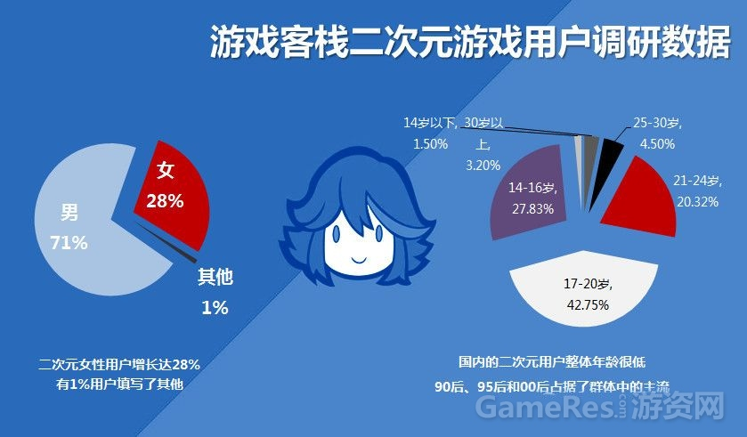
Open Cherry
PRESENTATION//SLIDE
into role-playing, enhancing emotional connections with the characters.
Part Three
User demographic analysis
SLIDE DESIGN
TEMPLATE
Role-playing and Engagement
By designing outfits and adjusting poses, players can immerse themselves deeper into role-playing, enhancing emotional connections with the characters.
添加标题内容
单击此处输入你正文内容，文字是您思想的提炼，为了演示发布的良好效果，尽量言简意赅阐述观点
MARKETING PLAN

Slide 16

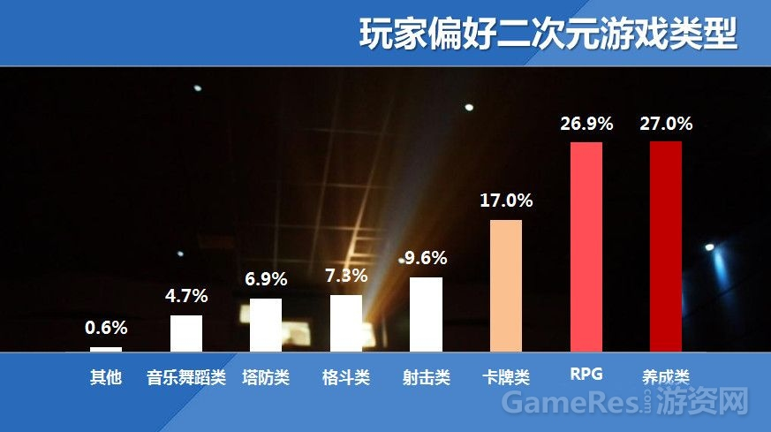
Part Three
User demographic analysis
SLIDE DESIGN
TEMPLATE
Social Interaction and Sharing
Players can receive feedback from other players and engage in creative exchanges and collaborations.
MARKETING PLAN

Slide 17
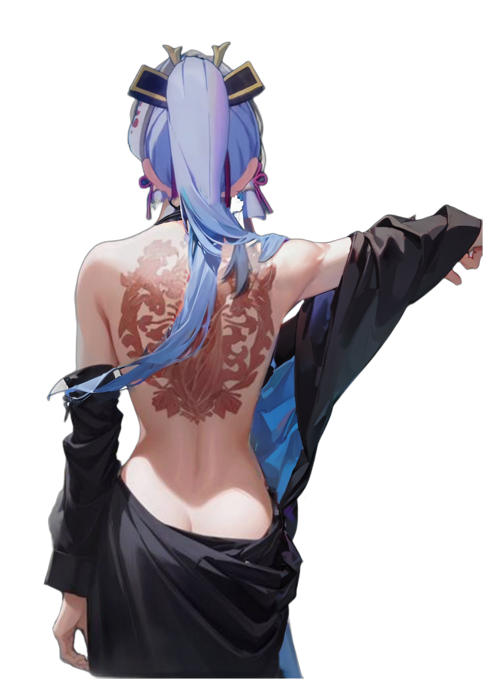
OPENCHERRY
市场营销
MARKETING
04
PART FOUR
www.opencherry.com
MARKETING

Slide 18
WPS TEMPLATE
PRESENTATION//SLIDE
、
Main means
Part Four
SLIDE DESIGN
TEMPLATE
Early attraction
Trial phase
Medium term investment
Post expansion
MARKETING PLAN

Slide 19
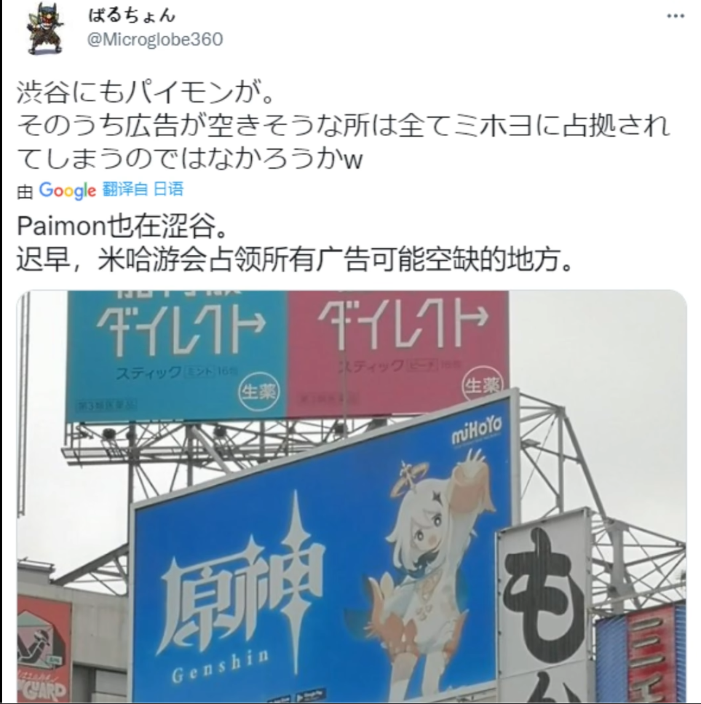
WPS TEMPLATE
PRESENTATION//SLIDE
Preliminary work
Part Four
SLIDE DESIGN
TEMPLATE
①Early attraction
1.Collaborate with KOLs related to the clothing industry to promote and enhance brand credibility.
2. Set up Weibo, Instagram, YouTube, etc., set up live streaming rooms, draw bullet comments to give away VIP gifts, etc.
3. At the same time, place large promotional posters in shopping centers.
MARKETING PLAN

Slide 20
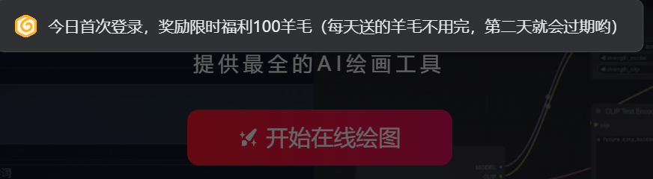

WPS TEMPLATE
PRESENTATION//SLIDE
Preliminary work
Part Four
SLIDE DESIGN
TEMPLATE
②Trial phase
②Trial phase
1.Launch a free usage campaign, allowing new users to use 100 times for free and encouraging user experience; 2.Simultaneously setting up an invitation reward mechanism, inviting relatives and friends to register to increase the free quota.
MARKETING PLAN

Slide 21
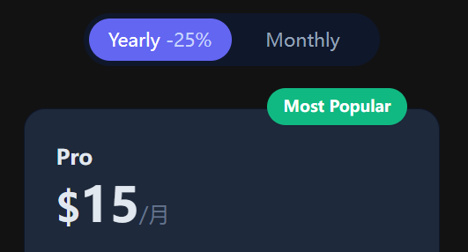
WPS TEMPLATE
PRESENTATION//SLIDE
Medium term investment
Preliminary work
Part Four
SLIDE DESIGN
TEMPLATE
③Medium term investment
Organize online and offline activities, such as annual membership fracture promotions, lucky draws and so on, to attract user participation and increase sales.
MARKETING PLAN

Slide 22
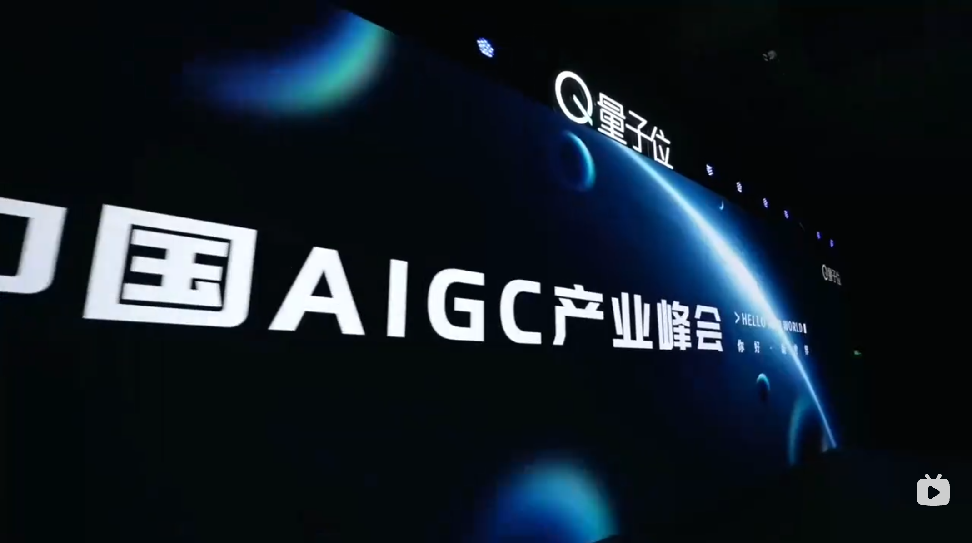

WPS TEMPLATE
PRESENTATION//SLIDE
Preliminary work
Part Four
SLIDE DESIGN
TEMPLATE
②Trial phase
④Post expansion
Consolidate market position, conduct roadshows such as the China Industry AIGC Summit, seek sponsorship and investment opportunities, collaborate with other industries, and enhance brand influence.
MARKETING PLAN

Slide 23

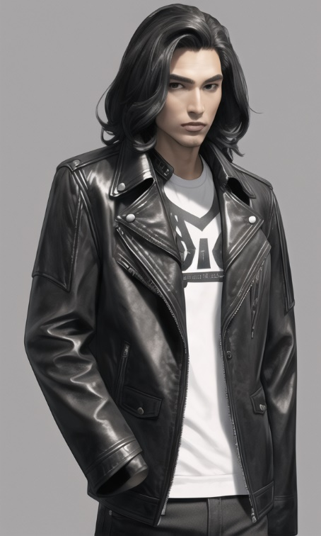


Join us !
www.opencherry.com
MARKETING
OPENCHERRY

